Slide 1




ISA 401/501: Business Intelligence & Data Visualization
02: Introduction to
Fadel M. Megahed, PhD
Enders Associate Professor Farmer School of Business Miami University
@FadelMegahed fmegahed fmegahed@miamioh.edu
Automated Scheduler for Office Hours
Fall 2022

Slide 2
Quick Refresher from Last Class
✅ Describe course objectives & structure
✅ Define data visualization & describe its main goals
❌ Describe the BI methodology and major concepts
2 / 50

Slide 3
Learning Objectives for Today's Class
Describe why we are using in this course?
Understand the syntax, data structures and functions.
Utilize the project workflow in and create your second script.
3 / 50

Slide 4
4 / 50

Slide 5
Pedagogy Behind Using in this Course [1]
crashes =
reading the data directly from the source
read_csv("https://data.cincinnati-oh.gov/api/views/rvmt-pkmq/rows.csv?accessType=DOWNLOAD"
changing all variable names to snake_case clean_names() %>%
selecting variables of interest
select(address_x, latitude_x, longitude_x, cpd_neighborhood, datecrashreported, instanceid
engineering some features from the data mutate(
datetime = parse_date_time(datecrashreported, orders = "'%m/%d/%Y %I:%M:%S %p", tz = 'A
hour = hour(datetime),
date = as_date(datetime) )
The Beauty of Programming Languages
Programming languages are languages.
It's just text -- which gives you access to two extremely powerful techniques!!!
Source: Content in "The Beauty of Programming Languages" is from Hadley Wickham's You Can't Do Data Science in a GUI
5 / 50

Slide 6



Pedagogy Behind Using in this Course [2]
The Beauty of Programming Languages (Continued)
Ctrl + C
Ctrl + V
In addition, programming languages are generally
Readable (IMO way easier than trying to figure what someone did in an )
Open (so you can it)
Reusable and reproducible (so you can reuse your code for similar problems and other people can get the same results as you easily)
Diffable (version control is extremely powerful)
Source: The bullets in "The Beauty of Programming Languages" are based on Hadley Wickham's You Can't Do Data Science in a GUI
6 / 50

Slide 7

Pedagogy Behind Using
in this Course [3]
Why Specifically?
It is a general-purpose programming language, which originated for statistical analysis.
As of Aug 23, 2022, there are 18,491 packages on CRAN (not including those on ).
The tidyverse group of packages have simplified the workflow for data analytics/science.
7 / 50

Slide 8


(Any Programming
How to Learn Language)
🗣 Get hands dirty‼
📖 Documentation! Documentation! Documentation!
🔎 (Not surprisingly) Learn to Google: what that error message means (I
a lot 😂)
Source: Slide is based on Kia Ora's How I Learn a Technology.
8 / 50

Slide 9
The RStudio Interface, Setup and a Project- Oriented Workflow for your Analysis
9 / 50

Slide 10
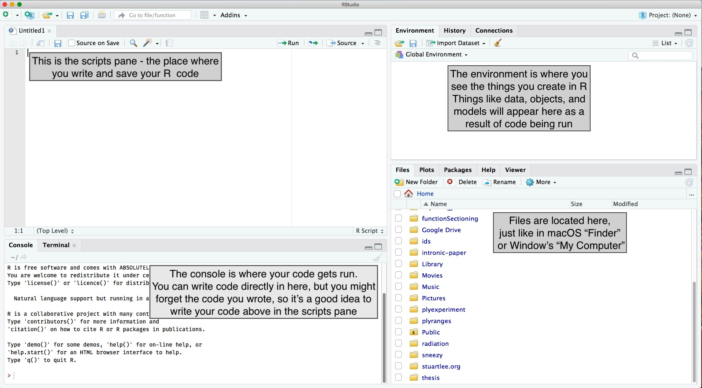
RStudio Interface
image credit: Stuart Lee
10 / 50

Slide 11
Setting up RStudio (do this once)
Go to Tools > Global Options:
Uncheck Workspace and History, which helps to keep working environment fresh and clean every time you switch between projects.
11 / 50

Slide 12
What is a project?
Each university course is a project, and get your work organised.
A self-contained project is a folder that contains all relevant files, for example my ISA 401/
📁 includes:
isa401.Rproj
lectures/
01_Introduction/
01-Introduction.Rmd, etc.
02_Introduction_to_R/
02_introduction_to_r.Rmd, etc.
All working files are relative to the project root (i.e. isa401/).
The project should just work on a different computer.
12 / 50

Slide 13
101: Operators
13 / 50

Slide 14
Assignment
has three assignment operators: <-, =, and ->, which can be used as follows.
x1 <- 5
x2 = 5
5 -> x3
print(paste0("The values of x1, x2, and x3 are ", x1, ", ", x2, ", and ", x3, " respectively
## [1] "The values of x1, x2, and x3 are 5, 5, and 5 respectively"
The assignment consists of three parts:
The left-hand side: variable names (x1 or x2),
The assignment operator: <- (or alternatively =), and
The right-hand side: values (5)
14 / 50

Slide 15
Retrieval
We can retrieve/call the object using its name as follows:
x1
## | [1] | 5
x3
## | [1] | 5
15 / 50

Slide 16
Retrieval: Three Common Errors
Case issue: object names in are case sensitive.
X1 # should be x1 instead of X1 (see last slide)
## Error in eval(expr, envir, enclos): object 'X1' not found
16 / 50

Slide 17
Retrieval: Three Common Errors
Case issue: object names in are case sensitive.
X1 # should be x1 instead of X1 (see last slide)
## Error in eval(expr, envir, enclos): object 'X1' not found
Typo: A spelling error of some sort
y3 | should | be x3 instead of y3 (see last slide)
## | Error in | eval(expr, envir, enclos): object 'y3' | not | found
16 / 50

Slide 18
Retrieval: Three Common Errors
Case issue: object names in are case sensitive.
X1 # should be x1 instead of X1 (see last slide)
## Error in eval(expr, envir, enclos): object 'X1' not found
Typo: A spelling error of some sort
y3 # should be x3 instead of y3 (see last slide)
## Error in eval(expr, envir, enclos): object 'y3' not found
Object not saved: e.g., you clicked Enter instead of Ctrl + Enter when running your code
rm(x2) # removing x2 from the global environment to mimic error x2 # x2 is not in the global environment (see environment)
16 / 50

Slide 19
Arthimetic Operators
While we will not specifically talk about doing math in
, the operators below are good to know.
Operator | Description
+ | addition
- | subtraction
* | multiplication
/ | division
^ or ** | exponentiation
x %% y | modulus (x mod y) 5%%2 is 1
x %/% y
integer division 5%/%2 is 2
Source: The above table is scraped from Quick-R: Operators.
17 / 50

Slide 20
Logical Operators
Logical operators are operators that return TRUE and FALSE values.
Operator
Description
<
less than
<=
less than or equal to
>
greater than
>=
greater than or equal to
==
exactly equal to
!=
not equal to
!x
Not x
x | y
x OR y
x & y
x AND y
isTRUE(x)
test if X is TRUE
Source: The above table is also scraped from Quick-R: Operators.
18 / 50

Slide 21
101: Syntax, Data Types, Data Structures and Functions
19 / 50

Slide 22
Coding Style
Good coding style is like correct punctuation: you can
manage without it, butitsuremakesthingseasiertoread.
-- The tidyverse style guide
style guide
❌ camelCase (Javascript)
❌ PascalCase (Python)
✅ snake_case
Source: Slide is based on Earo Wang's STAT 220 Slides
20 / 50

Slide 23
is a Vector Language: Sample Output
Learning from a sample of ten obs. from the standard normal distribution (i.e., x ∼ N (0, 1))
x_vec = | rnorm(n=10, | mean = 0, sd = 1) | generating std normal dist data
x_vec > | 0 # finding | which elements in | x are larger than 0
## [1] FALSE FALSE TRUE TRUE TRUE FALSE TRUE FALSE FALSE FALSE
sum(x_vec > 0) # summing the number of elements (i.e., how many are > 0)
## [1] 4
21 / 50

Slide 24
is a Vector Language: Sample Output
Learning from a sample of ten obs. from the standard normal distribution (i.e., x ∼ N (0, 1))
x_vec = | rnorm(n=10, | mean = 0, sd = 1) | generating std normal dist data
x_vec > | 0 # finding | which elements in | x are larger than 0
## [1] FALSE FALSE TRUE TRUE TRUE FALSE TRUE FALSE FALSE FALSE
sum(x_vec > 0) # summing the number of elements (i.e., how many are > 0)
## [1] 4
If we focus on the obtained outputs, we can see that both are vectors:
x_vec > 0 returns a vector of size 10 (TRUE/FALSE for each element)
sum(x_vec > 0) returns a vector of size 1
21 / 50

Slide 25
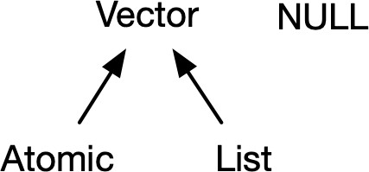
is a Vector Language: Types and Attributes
Vectors come in two flavors, which differ by their elements' types:
atomic vectors -- all elements
must have the same type
lists -- elements can be different
Vector have two important attributes:
Dimension turns vectors into matrices and arrays, checked using dim(object_name).
The class attribute powers the S3 object system, checked using class(object_name).
class(x_vec)
## [1] "numeric"
Source: The content and image are from Hadley Wickham's Advanced R: Chapter 3 on Vectors
22 / 50

Slide 26
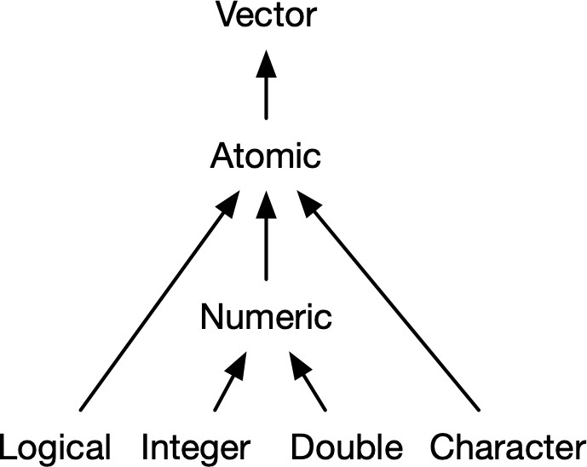
is a Vector Language: Atomic Vectors
dim(x_vec)
## NULL
Atomic vectors have a dim of NULL, which distinguishes it from 1D arrays 😲!!!
Source: The image is from Hadley Wickham's Advanced R: Chapter 3 on Vectors
23 / 50

Slide 27
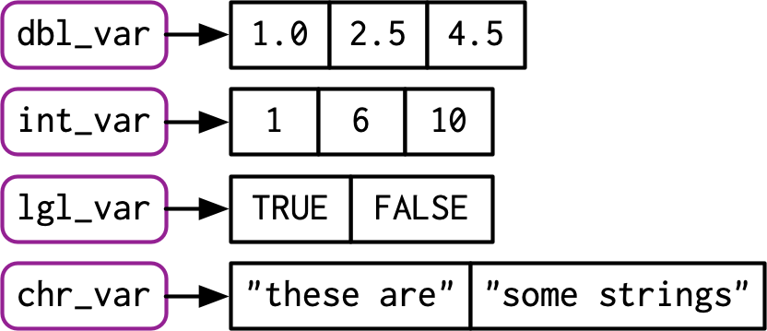
Data Types: A Visual Introduction [1]
To check the type of an object in , you can use the function typeof:
typeof(x_vec)
## [1] "double"
Source: The image is from Hadley Wickham's Advanced R: Chapter 3 on Vectors
24 / 50

Slide 28
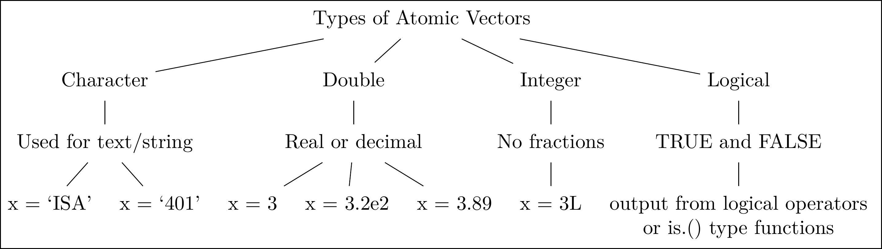
Data Types: A Visual Introduction [2]
The four data types that we will utilize the most in our course.
25 / 50

Slide 29
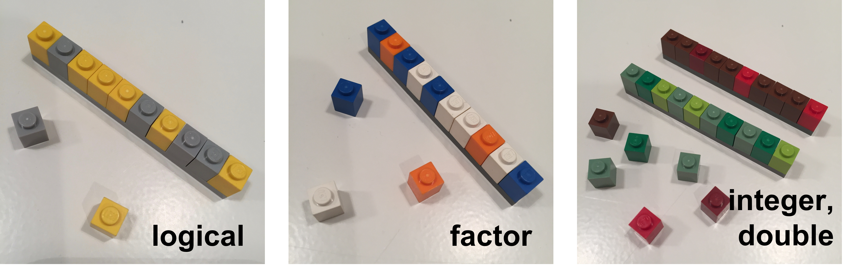
Data Types: A Visual Introduction [3]
A visual representation of different types of atomic vectors
Source: The images are from the excellent lego-rstats GitHub Repository by Jenny Bryan
26 / 50

Slide 30
Data Types: Formal Definitions
Each of the four primary types has a special syntax to create an individual value:
Logicals can be written in full (TRUE or FALSE), or abbreviated (T or F).
Doubles can be specified in decimal (0.1234), scientific (1.23e4), or hexadecimal (0xcafe) form.
There are three special values unique to doubles: Inf, -Inf, and NaN (not a number).
These are special values defined by the floating point standard.
Integers are written similarly to doubles but must be followed by L(1234L, 1e4L, or
0xcafeL), and can not contain fractional values.
Strings are surrounded by " (e.g., "hi") or ' (e.g., 'bye'). Special characters are escaped with \ see ?Quotes for full details.
Source: The content of this slide is verbatim from Hadley Wickham's Advanced R: Chapter 3 on Vectors
27 / 50

Slide 31
Data Structures: Atomic Vector (1D)
Keeping the visual representation of different types of atomic vectors in your head!!
dept = c('ACC', 'ECO', 'FIN', 'ISA', 'MGMT') nfaculty = c(18L, 19L, 14L, 25L, 22L)
Source: The images are from the excellent lego-rstats GitHub Repository by Jenny Bryan
28 / 50

Slide 32
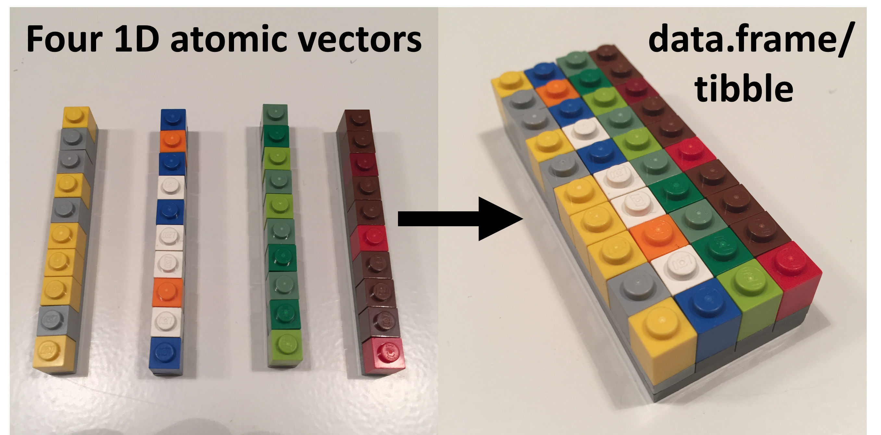
Data Structures: 1D ➡ 2D [Visually]
Source: The images are from the excellent lego-rstats GitHub Repository by Jenny Bryan
29 / 50

Slide 33
Data Structures: 1D ➡ 2D [In Code]
library(tibble)
fsb_tbl <- tibble( department = dept, count = nfaculty,
percentage = count / sum(count)) fsb_tbl
## # A tibble: 5 × 3
## department count percentage
## <chr> |  |  | <int> | <dbl>
## | 1 | ACC | 18 | 0.184
## | 2 | ECO | 19 | 0.194
## | 3 | FIN | 14 | 0.143
## | 4 | ISA | 25 | 0.255
## | 5 | MGMT | 22 | 0.224
30 / 50

Slide 34
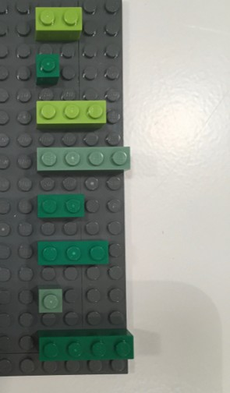
Data Structures: Lists [1]
An object contains elements of different data types.
Source: The image is adapted from the excellent lego-rstats GitHub Repository by Jenny Bryan
31 / 50

Slide 35
Data Structures: Lists [2]
lst <- list( # list constructor/creator
1:3, # atomic double/numeric vector of length = 3
"a", # atomic character vector of length = 1 (aka scalar) c(TRUE, FALSE, TRUE), # atomic logical vector of length = 3 c(2.3, 5.9) # atomic double/numeric vector of length =3
)
lst # printing the list
## [1] "1:3"
## [4] "c(2.3, 5.9)"
"a"
"c(TRUE, FALSE, TRUE)"
Source: Image is from Hadley Wickham's Advanced R: Chapter 3 on Vectors
32 / 50

Slide 36
Data Structures: Lists [3]
data type
data structure
typeof(lst) # primitive type
str(lst)
sublists can be of diff lengths and typ
## [1] "list"
## List of 4
data class
## | $ : | int [1:3] | 1 2 3
## | $ : | chr "a"
## | $ : | logi [1:3] TRUE FALSE TRUE
## | $ : | num [1:2] 2.3 5.9
class(lst) # type + attributes
## [1] "list"
Source: Slide is based on Earo Wang's STAT 220 Slides.
33 / 50

Slide 37
Data Structures: Lists [3]
A list can contain other lists, i.e. recursive
a named list str(
list(first_el = lst, second_el = iris)
)
## List of 2
## $ first_el :List of 4 ## ..$ : int [1:3] 1 2 3
## ..$ : chr "a"
## ..$ : logi [1:3] TRUE FALSE TRUE ## ..$ : num [1:2] 2.3 5.9
##
## ## ## ## ##
$ second_el:'data.frame': 150 obs. of 5 variables:
..$ Sepal.Length: num [1:150] 5.1 4.9 4.7 4.6 5 5.4 4.6 5 4.4 4.9 ...
..$ Sepal.Width : num [1:150] 3.5 3 3.2 3.1 3.6 3.9 3.4 3.4 2.9 3.1 ...
..$ Petal.Length: num [1:150] 1.4 1.4 1.3 1.5 1.4 1.7 1.4 1.5 1.4 1.5 ...
..$ Petal.Width : num [1:150] 0.2 0.2 0.2 0.2 0.2 0.4 0.3 0.2 0.2 0.1 ...
..$ Species : Factor w/ 3 levels "setosa","versicolor",..: 1 1 1 1 1 1 1 1 1 1 ...
34 / 50

Slide 38
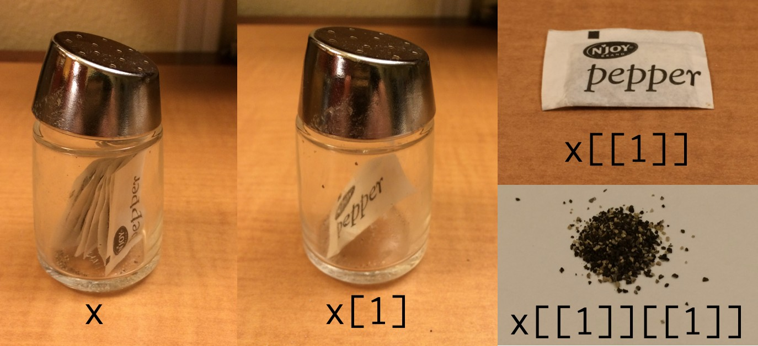
Data Structures: Lists [4]
Subset by []
Subset by [[]]
lst[1]
lst[[1]]
## [[1]]
## [1] 1 2 3
## [1] 1 2 3
Sources: The slide is based on Earo Wang's STAT 220 slides and image is from Hadley Wickham's Tweet on Indexing lists in R.
35 / 50

Slide 39
Data Structures: Matrices
A matrix is a 2D data structure made of one/homogeneous data type.
x_mat = matrix( sample(1:10, size = 4), n str(x_mat) # its structure?
## int [1:2, 1:2] 9 1 2 6
x_mat # printing it nicely print(' ')
x_mat[1, 2] # subsetting
## [,1] [,2]
## [1,] 9 2
## [2,] 1 6
## [1] " "
## [1] 2
36 / 50

Slide 40
Data Structures: Matrices
A matrix is a 2D data structure made of one/homogeneous data type.
x_mat = matrix( sample(1:10, size = 4), n str(x_mat) # its structure?
x_char = matrix(
sample(letters, size = 12), nrow = 3, n x_char
## int [1:2, 1:2] 9 1 2 6
## | [,1] [,2] | [,3] | [,4]
## [1,] | "h" "j" | "n" | "s"
## [2,] | "y" "c" | "q" | "i"
## [3,] | "p" "m" | "f" | "e"
x_mat # printing it nicely print('-----------------')
x_mat[1, 2] # subsetting
x_char[1:2, 2:3] # subsetting
## [,1] [,2]
## [1,] 9 2
## [2,] 1 6
## [1] "-----------------"
## [1] 2
## [,1] [,2]
## [1,] "j" "n"
## [2,] "c" "q"
36 / 50

Slide 41
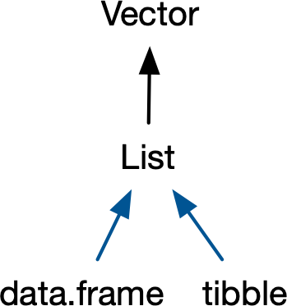
Data Structures: Data Frames [1]
If you do data analysis in R, you’re going to be using data
frames. A data frame is a named list of vectors with
attributes for (column) names, row.names, and its class, “data.frame”. -- Hadley Wickham
Source: Image is from Hadley Wickham's Advanced R: Chapter 3 on Vectors
37 / 50

Slide 42
Data Structures: Data Frames [2]
df1 <- data.frame(x = typeof(df1) # showing |  | 1:3, that | y = letters[1:3]) its a special case of a list
## [1] "list"
attributes(df1) # but |  | also | is of class data.frame
## | $names
## ## | [1] "x" "y" $class
## ## ## | [1] "data.frame" $row.names
## | [1] 1 2 3
##
In contrast to a regular list, a data frame has an additional constraint: the length of each of its
vectors must be the same. This gives data frames their rectangular structure.
Source: Content is from Hadley Wickham's Advanced R: Chapter 3 on Vectors
38 / 50

Slide 43
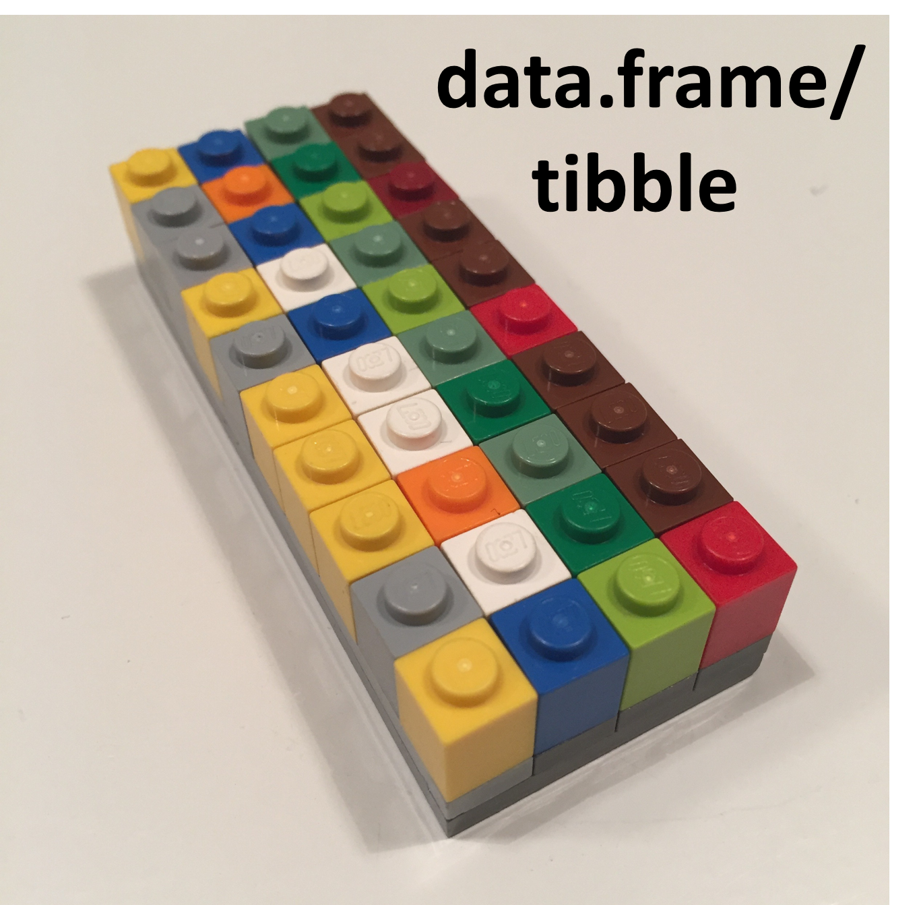
Data Structures: Data Frames [3]
As noted in the creation of df1, columns in a data frame can be of different types. Hence, it is more widely used in data analysis than matrices.
Source: The image is adapted from the excellent lego-rstats GitHub Repository by Jenny Bryan
39 / 50

Slide 44
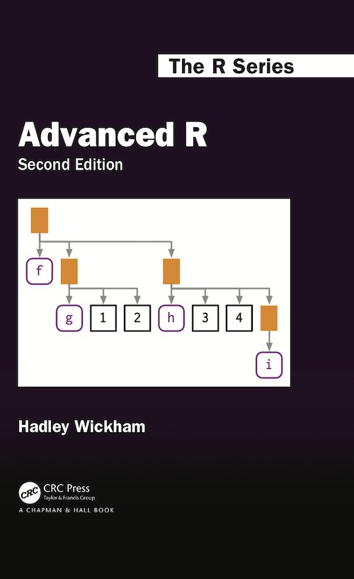
Data Structures: So What is a Tibble Anyway?
Tibble is a modern reimagining of the data frame. Tibbles are designed to be (as
much as possible) drop-in replacements for data frames that fix those frustrations. A concise, and fun, way to summarise the main differences is that tibbles are lazy and surly: they do less and complain more. -- Hadley Wickham
To learn more about the basics of tibble, please consult the reference below:
Data frames and tibbles (Click and read from 3.6 up to and including 3.6.5)
40 / 50

Slide 45
Functions
A function call consists of the function name followed by one or more argument within parentheses.
temp_high_forecast = c(86, 84, 85, 89, 89, 84, 81) mean(x = temp_high_forecast)
## [1] 85.42857
function name: mean(), a built-in R function to compute mean of a vector
argument: the first argument (LHS x) to specify the data (RHS temp_high_forecast)
Source: Slide is based on Earo Wang's STAT 220 Slides
41 / 50

Slide 46
02:00
Function Help Page
Check the function's help page with ?mean
Class Activity
Please take 2 minutes to investigate the help page for mean in R Studio.
mean(x = temp_high_forecast, trim = 0, na.rm = FALSE, ...)
Read Usage section
What arguments have default values?
Read Arguments section
What does trim do?
Run Example code
Source: Slide is based on Earo Wang's STAT 220 Slides
42 / 50

Slide 47

Function Arguments
Match by positions
Match by names
mean(temp_high_forecast, 0.1, TRUE)
mean(x = temp_high_forecast, trim = 0.1,
## [1] 85.42857
## [1] 85.42857
Source: Slide is based on Earo Wang's STAT 220 Slides
43 / 50

Slide 48
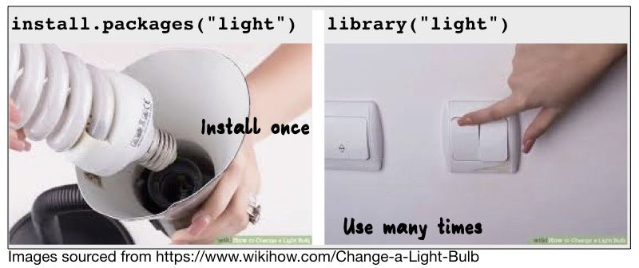
Use Functions from Packages
library(dplyr) cummean(temp_high_forecast)
## [1] 86.00000 85.00000 85.00000 86.0000
first(temp_high_forecast)
## [1] 86
last(temp_high_forecast)
## [1] 81
Source: Slide is based on Earo Wang's STAT 220 Slides
44 / 50

Slide 49
Write Your Own Functions
function_name <- function(arguments) { # function_body
}
my_mean <- function(x, na.rm = FALSE) { summation <- sum(x, na.rm = na.rm) summation / length(x)
}
my_mean(temp_high_forecast)
## [1] 85.42857
Source: Slide is based on Earo Wang's STAT 220 Slides
45 / 50

Slide 50
Demo
46 / 50

Slide 51
Your Second
Script File
Refer to our in class code.
47 / 50

Slide 52
Recap
48 / 50

Slide 53
Summary of Main Points
By now, you should be able to do the following:
Describe why we are using in this course?
Understand the syntax, data structures and functions.
Utilize the project workflow in and create your first R script.
49 / 50

Slide 54
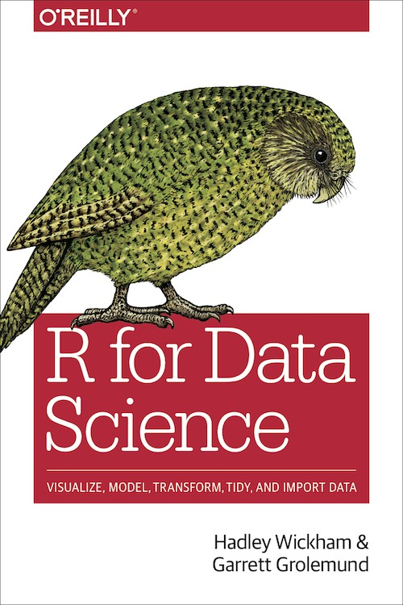
Things to Do to Prepare for Our Next Class
Go over your notes, read the references below, and complete the self-paced R tutorial.
Complete Assignment 02 on Canvas.
Workflow: basics
Workflow: scripts
Workflow: project
Names and values
Vectors
Subsetting
50 / 50

